Slide 1

HI What’s up???

Slide 2
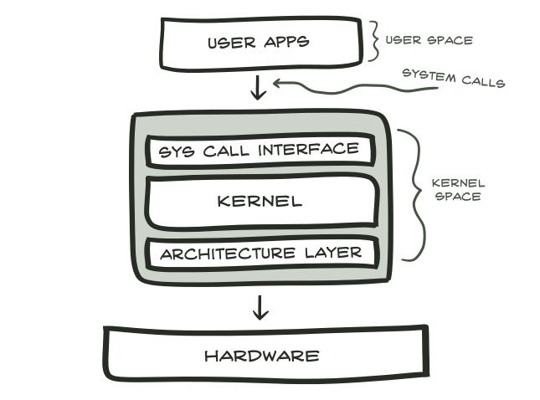
System Calls
A system call is as good as a function in C Programming Language.
Functions are limited to programming while system calls are specific for operating systems.

Slide 3
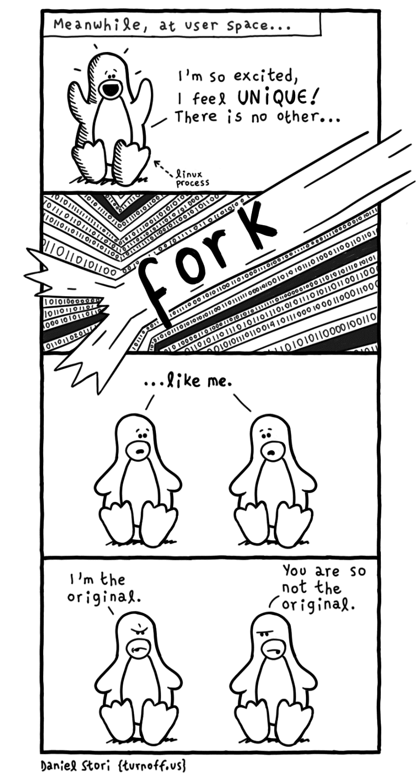
Fork()

Slide 4
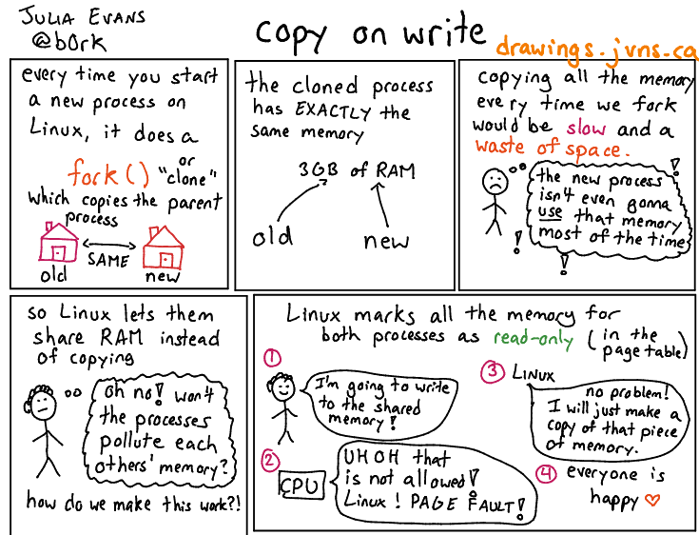
Copy On Write COW

Slide 5
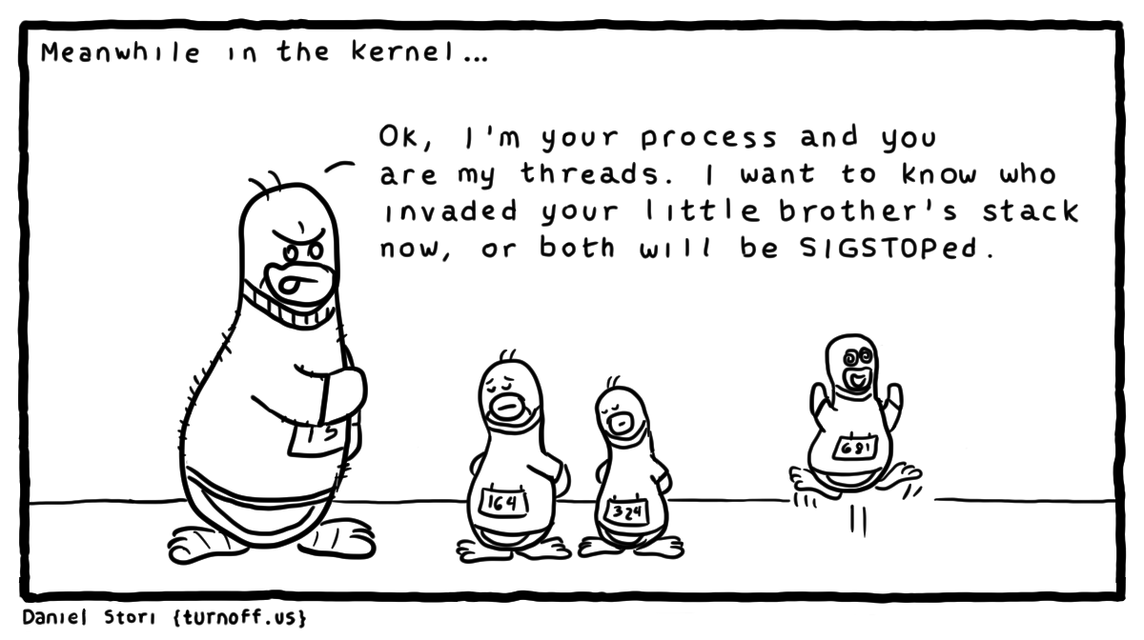
Threads within a Process

Slide 6
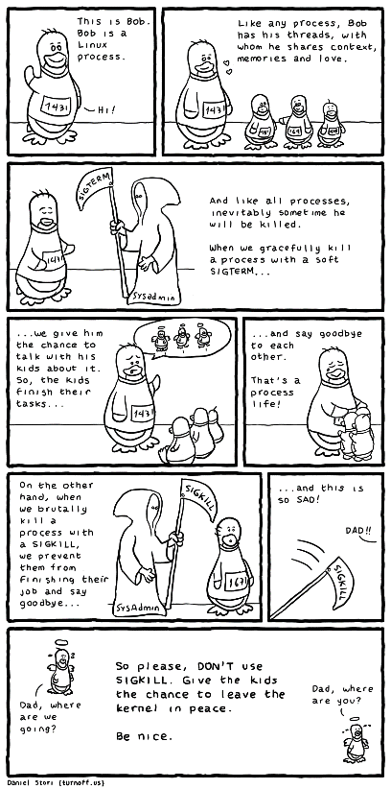
SIGTERM= When you shutdown
SIGKILL= Fatal

Slide 7
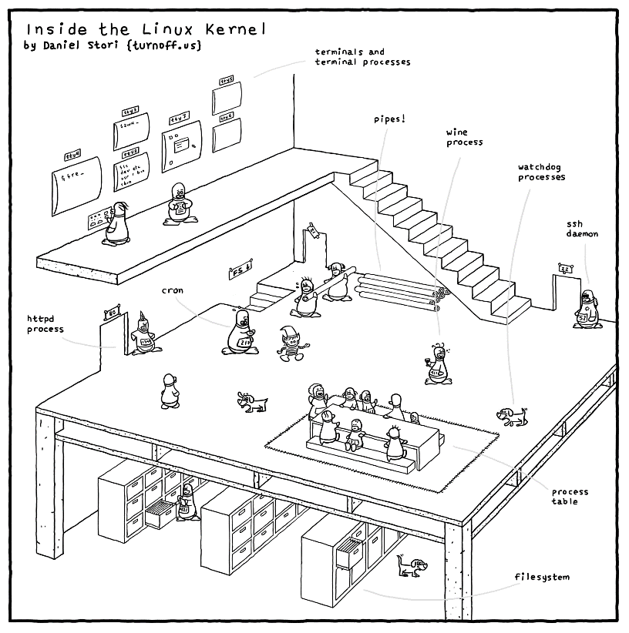

Slide 8
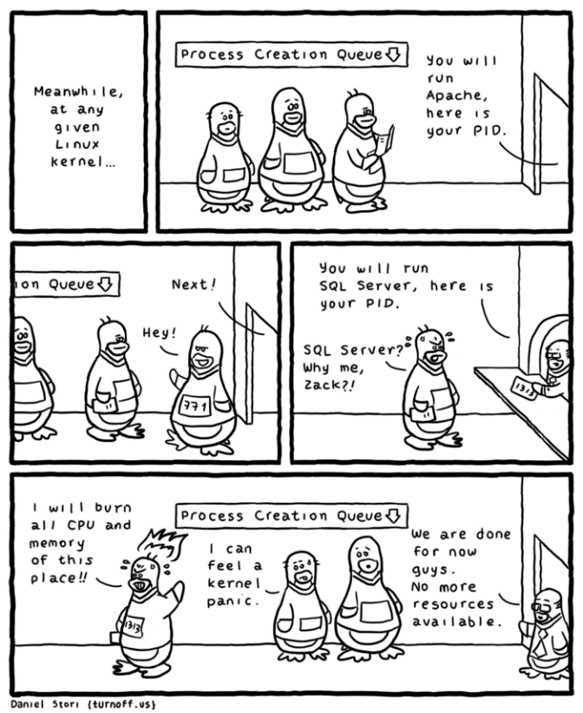

Slide 9
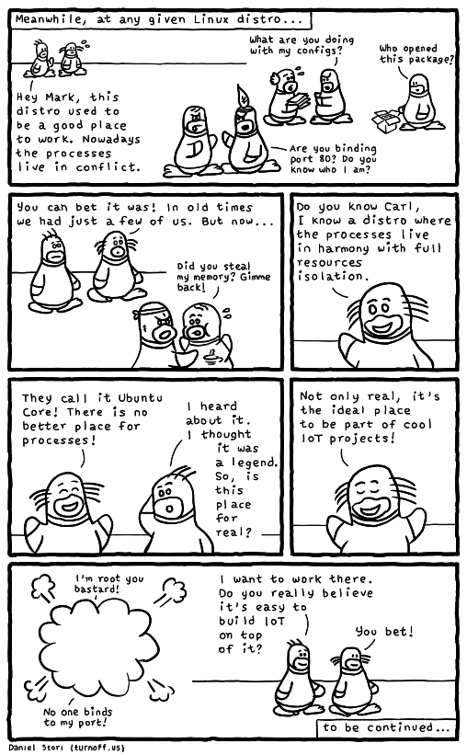
IoT

Slide 10
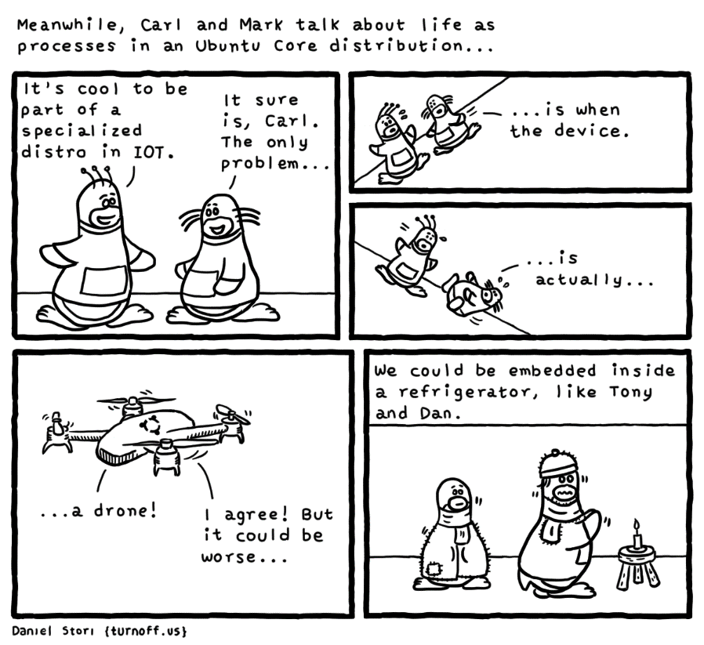

Slide 11
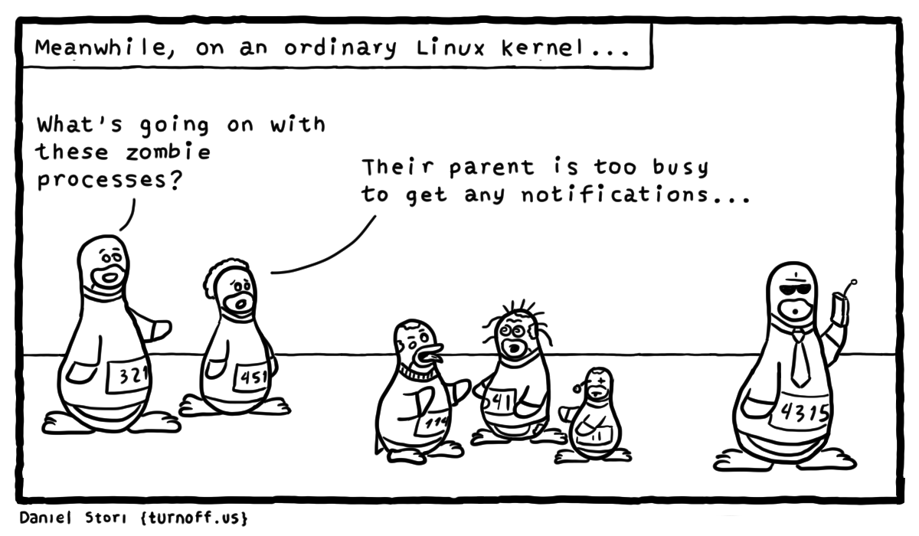
Zombie Process

Slide 12
Orphan Process
I couldn’t find the picture ☹

Slide 13
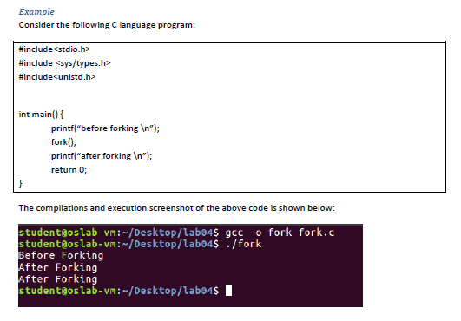
Example

Slide 14
Best of luck for Manual 4
Have A nice journey!

